Slide 1
Hope-Hill Elementary IGNITE HOPE
Annual Title I
Curriculum Night
August 22,2023

Slide 2
Agenda
Agenda
Staff Introductions
What you need to know about Title I
Testing
School Goals-CIP
Parent and Family Engagement
Playground Input
STEAM
SEL
Closing

Slide 3
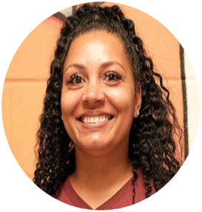
Keisha Gibbons Principal
Adrienne McCrary Assistant Principal
Nicole Fluker RELA Instructional Coach
Latrice Green Math Instructional Coach
Kristen Lyle
STEAM
Ashley Anderson
Parent Liaison
Takara McGee
SSW
Kenneth Robbins
Counselor

Slide 4
What you need to know about Title I
What Is Title I?
What is the Schoolwide Improvement Plan?
What are our goals?
What curriculum does our school use?
What tests will my scholar take?
STEAM

Slide 5
Title I programs must be based on effective means of improving student achievement and include strategies to support parent and family engagement.
It’s the largest federal aid program for public schools in the United States.
Title I is designed to support State and local school reform efforts tied to the challenging State academic standards to improving teaching and learning for students.

Slide 6
What test will my child take?
THE VARIOUS ASSESSMENTS GIVEN:
THE PROFICIENCY LEVELS FOR THE GEORGIA MILESTONES
Begin​​​ning Learners do not yet demonstrate proficiency in the knowledge and skills necessary at this grade level/course of learning, as specified in Georgia’s content standards. The students need substantial academic support to be prepared for the next grade level or course and to be on track for college and career readiness.
Developing Learners demonstrate partial proficiency in the knowledge and skills necessary at this grade level/course of learning, as specified in Georgia’s content standards. The students need additional academic support to ensure success in the next grade level or course and to be on track for college and career readiness.
Proficient Learners demonstrate proficiency in the knowledge and skills necessary at this grade level/course of learning, as specified in Georgia’s content standards. The students are prepared for the next grade level or course and are on track for college and career readiness.
Distinguished Learners demonstrate advanced proficiency in the knowledge and skills necessary at this grade level/course of learning, as specified in Georgia’s content standards. The students are well prepared for the next grade level or course and are well prepared for college and career readiness.
K-3 MAP Reading Fluency
Acadience Reading (K-3)
K-5 MAP Growth Reading and Math
Write Score (2-5)
Milestones- End of year/grade statewide assessment

Slide 7
Achievement Norms

Slide 8
Curriculum Night Principal's Report
Keisha Gibbons
August 2023

Slide 9
School Goals-CIP
By May 2024, the number of students scoring Proficient or above on ELA GMAS will increase from 30 students to 50 students.
The CCRPI Attendance Rate will increase from 67.7% in May 2024 to 80.7%% by the end of the 2023-2024 school year.
By May 2024, the number of students scoring Proficient or above on Math GMAS will increase from 27 students to 47 students.

Slide 10
Strengths | Opportunities/Challenges
MAP growth data from fall to spring grades 2 –5 proficient and above increased from 23.9 to 27.2 in ELA | While attendance take rate is strong-98.3%, the ADA increased from 89 to 92.1% and the CCRPI Attendance increased from 50.3 to 67.7 from the 21-22 to 22-23, our CCRPI attendance is below 90%
MAP growth data from spring to spring grades 2 –5 proficient and above decreased from 15.1 to 17.61 in Math | MAP growth data from fall to spring grades 2 –5 proficient and above decreased from 26.6 to 17.61 in Math
Decreased the number of disciplinary incidents from 107 to 39 from 18/19 to 22-23 school year | The percentage of students preforming at proficient and above in ELA Milestones decreased by 15.9%
Attendance take rate is strong-98.3%, the ADA increased from 89 to 92.1% and the CCRPI Attendance increased from 50.3 to 67.7 from the 21-22 to 22-23 | The percentage of students preforming at proficient and above in Math Milestones decreased by 8.7%
Needs Assessment
Our Overarching Needs
Literacy: Increase the intentionality of personalized learning and individual reading levels. Increase the support for subgroups in reading and writing through more differentiation and project-based learning opportunities. Increase the number of opportunities for students to practice their writing skills. Intentional focus on enrichment and advanced learning opportunities our proficient and about students. | Numeracy: Increase the intentionality of personalized learning and small group instruction. Increase the use of manipulatives to build foundational skills. Intentional focus on enrichment and advanced learning opportunities our proficient and about students. | Whole Child & Student Support Implement the SAC with fidelity and monitor caseloads and data consistently. Collaborate with outside agencies to provide support to parents. Implement incentives for improvement with chronic absences.
Literacy Problem Statement | Numeracy Problem Statement | Whole Child & Student Support Problem Statement
Students with foundational skill gaps will receive personalized interventions through SOAR and EIP services to assist with closing academic gaps. | Students with foundational skill gaps will receive personalized interventions through SOAR and EIP services to assist with closing academic gaps. | Students who are in most need academically are often tardy or absent. CARE Team and SAC will monitor student attendance weekly.
Notes:
Notes for School CIP Teams: After completing your Comprehensive Needs Assessment ( data protocol), you will come here and identify some strengths and opportunities/challenges you have observed from the data. The priority areas are Literacy, Numeracy, and Whole Child & Student Support. Identify an overarching need for each area. Formulate a problem statement for each area. Make sure the problem statement meets the criteria. Refer to your CIP resources.

Slide 11
Ga. Milestone Data

Slide 12
Enrollment
 | PK | K | 1 | 2 | 3 | 4 | 5 | Total
Projected | 44 | 63 | 68 | 70 | 53 | 50 | 46 | 350
Enrolled | 37 | 64 | 62 | 69 | 49 | 51 | 59 | 354
Difference | -7 | +1 | -6 | -1 | -4 | +1 | +13 | +4
Present 8/22/2023 | 35 | 54 | 55 | 65 | 42 | 48 | 52 | 351

Slide 13
Staffing
 | PK | K* | 1 | 2* | 3 | 4 | 5 | SPED | EIP | Spec
Assigned | 4 | 8 | 3 | 4 | 3 | 3 | 3 | 11 | 5 | 6
Vacancy | 0 | 0 | 0 | 0 | 0 | 0 | 0 | *1 (awaiting transfer) | 0 | 0
Reason | 0 | 0 | 0 | 0 | 0 | 1* Visa | 0 | Behavior Para | 0 | 0

Slide 14
WHAT IS PARENT AND FAMILY ENGAGEMENT?
Parent and Family Engagement is an ongoing process that increases active participation, communication, and collaboration between parents, schools, and communities with the goal of educating the whole child to ensure student achievement and success.
What opportunities and events will the school offer parents?
Communicating and Partnering with Families
What is the School-Parent Compact?
What is the School Parent and Family Engagement Plan?
What is the District Parent and Family Engagement Statement?
What opportunities and events will the school offer parents?

Slide 15
School Parent and Family Engagement Plan
School Parent Compact
District Parent And Family Engagement Statement
The plan establishes the school’s expectations for parent and family engagement and describes how our school will implement a number of specific parent and family engagement activities, and it is incorporated into the school’s plan submitted to the local educational agency (LEA).
School parent compact outlines how the parents, the entire school staff, and the students will share the responsibility for improved student academic achievement as well as describes how the school and parents will build and develop a partnership that will help children achieve the state’s high standards.
The statement establishes Atlanta public school’s expectations and objectives for meaningful parent and family engagement and describes how the district will implement a number of specific parent and family engagement activities, and it is incorporated into the lea’s plan submitted to the Georgia Department of Education.

Slide 16
Playground Updates

Slide 17
STEAM@ Hope-Hill
Kristen Lyle: STEAM Program Specialist

Slide 18
STEAM?
S: Science
T: Technology
E: Engineering
A: Art
M: Math

Slide 19
STEAM Learner Profile
Excel Academically
Think Critically
Solve Problems Creatively
Investigate Thoroughly
Communicate Strategically
Collaborate Strategically
Utilize Technology
Compete Willingly

Slide 20
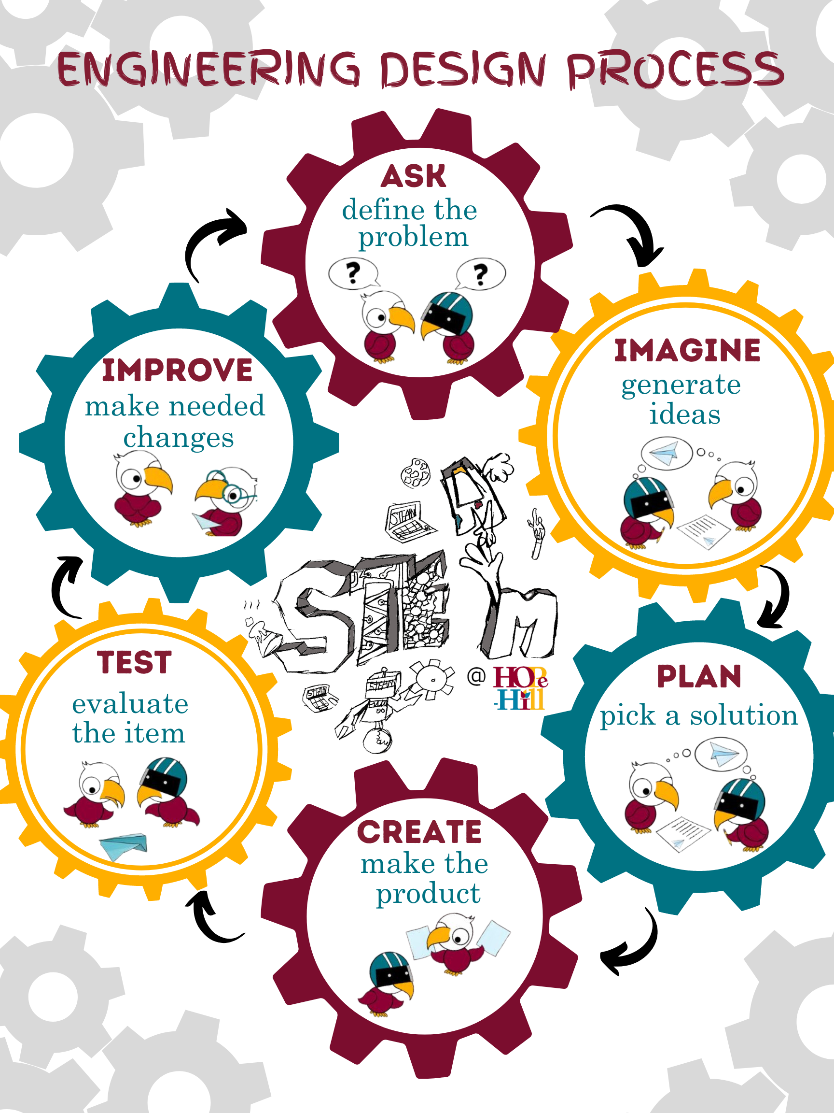

Slide 21
STEAM@Hope-Hill
Project-based learning: Quarterly
Long-term projects: on-going
Engineering Design Challenges

Slide 22
STEAM@Hope-Hill
One Fair: Due November 30th
Used as part of gifted talented measurement
Individual projects are mandatory for grades: 3rd-5th and class projects for the younger grades
Domain: Science, Social Studies, or Technology/Media

Slide 25
WHY SEL?
https://youtu.be/DqNn9qWoO1M

Slide 26
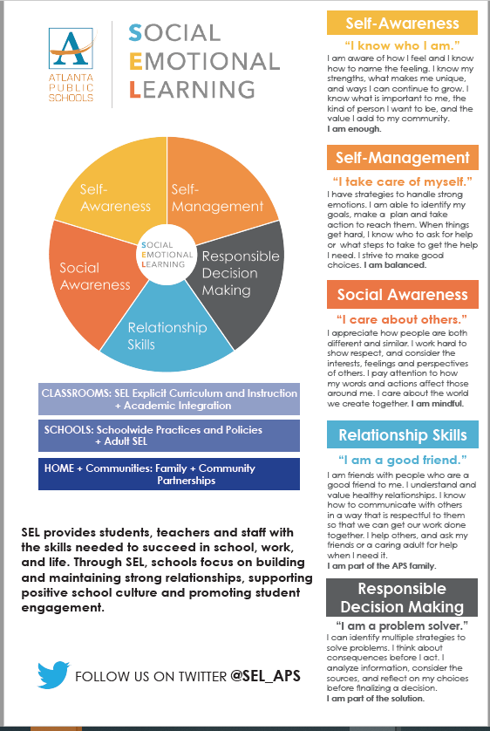

Slide 28
AFTER

Slide 29
Be On Time 7:15-7:45-On time 7:46-Tardy

Slide 30
COMMUNITY GATHERING

Slide 31
Questions?????

Slide 32
Where do I go next ?
Rotation 1: 6:15-6:30
Rotation 2: 6:35-6:50
Rotation 3: 6:55-7:10

Slide 33
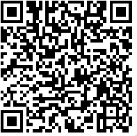
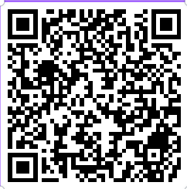
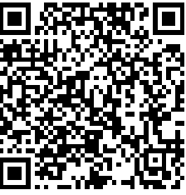
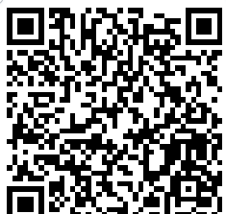
Grade Level/Department | Zoom Link | Zoom Code
Pre-Kindergarten |  | Meeting ID: 815 8499 4344 Passcode: 922419
Kindergarten |  | Meeting ID 899 1773 9479 Passcode 599615
First Grade |  | Meeting ID: 452 018 1755 Passcode: 172970
Second Grade |  | Meeting ID: 665 959 2759 Passcode: 294338

Slide 34
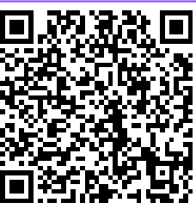
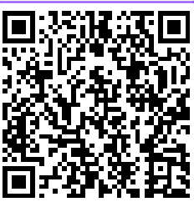
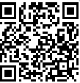
Grade Level/Department | Zoom Link | Zoom Code
Third Grade |  | Meeting ID: 741 389 338 Passcode: 000759
Fourth Grade |  | Meeting ID: 858 4035 4928 Passcode: 750794
Fifth Grade |  | Meeting ID: 324 522 7103 Passcode: 276533

Slide 35
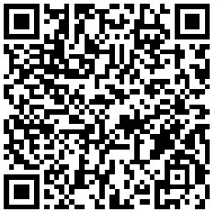
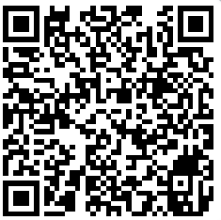
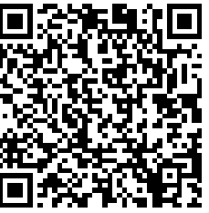
Grade Level/Department | Zoom Link | Zoom Code
Specials |  | Meeting ID: 842 0151 3567 Passcode: 338191
Ms. Fries |  | Meeting ID: 899 2995 0844 Passcode: 304
Ms. Campbell |  | Meeting ID: 873 341 4893 Passcode: Campbell

Slide 36
Thank you

